Slide 1
CSE101 – Lecture 15
STORAGE CLASS

Slide 2
What is Storage Class?
Storage class in C decides the part of storage to allocate memory for a variable, it also determines the scope of a variable.
All variables defined in a C program get some physical location in memory where variable’s value is stored.
Memory and CPU registers are types of memory locations where a variable’s value can be stored.
The storage class of a variable in C determines the life time of the variable if this is ’global’ or ’local’.
Along with the life time of a variable, storage class also determines variable’s storage location (memory or registers), the scope (visibility level) of the variable, and the initial value of the variable.
There are four storage classes in C those are automatic, register, static, and external.

Slide 3
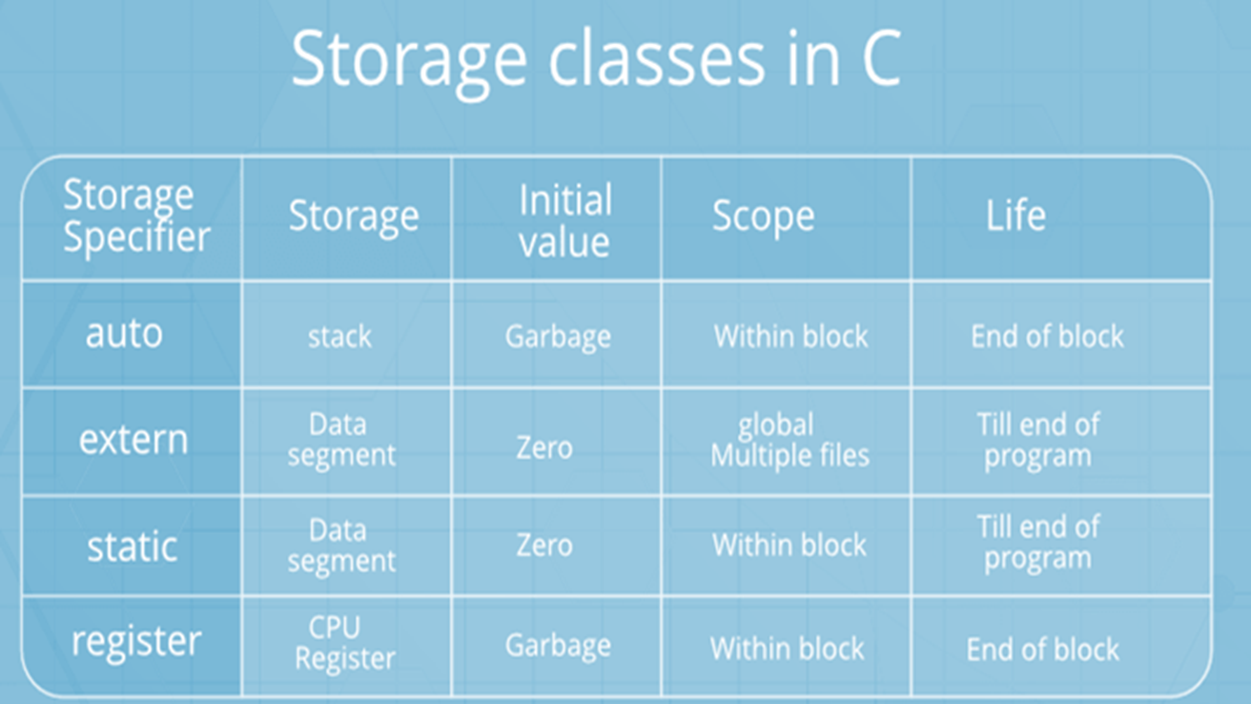
Types of Storage Classes

Slide 4
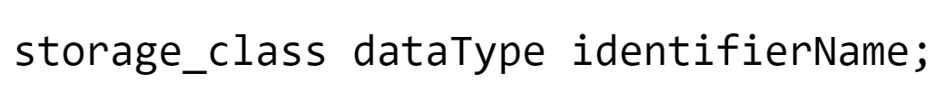
Syntax
These specifiers tell the compiler how to store the subsequent variable.

Slide 5
Few points related to storage class
At most one storage class specifier may be given in a declaration. If no storage class specifier is specified then following rules are used:
  Variables declared inside a function are taken to be auto.
  Functions declared within a function are taken to be extern
  Variables and functions declared outside a function are taken to be static, with external linkage.
  Variables and functions having external linkage are available to all files that constitute a program.
  File scope variables and functions declared as static have internal linkage. These are known only within the file in which they are declared.
  Local variables have no linkage and are therefore known only within their own block.

Slide 6
Let’s talk about variable scope and visibility

Slide 7
What is scope of an identifier?
The scope of an identifier is a part of the program in which the identifier can be used to access its object.
There are different types of scope:
  block (or local),
  function,
  function prototype, and
  file.
  These categories depend on how and where identifiers are declared.

Slide 8
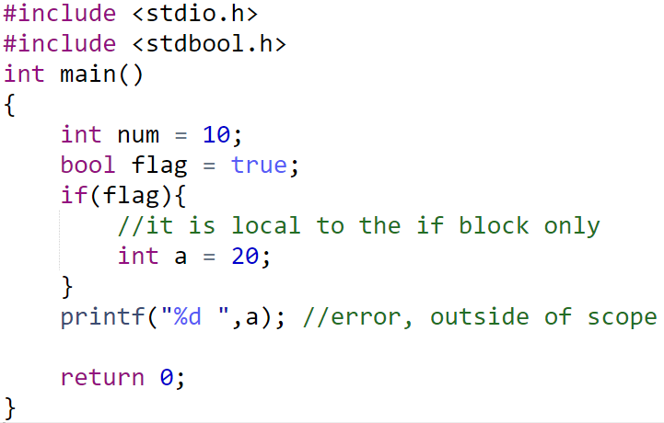
Block Scope
An identifier appearing within a block or in a parameter list of a function definition has block scope and is visible within the block, unless hidden by an inner block declaration.

Slide 9
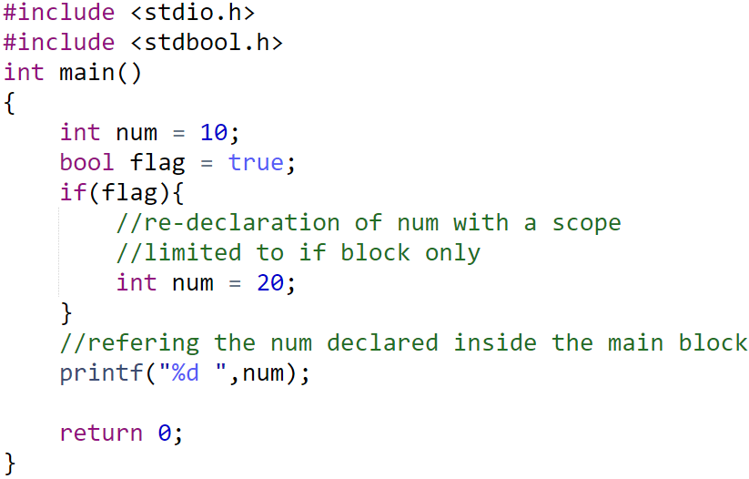
Block Scope
A variable can be re-declared inside an inner block

Slide 10
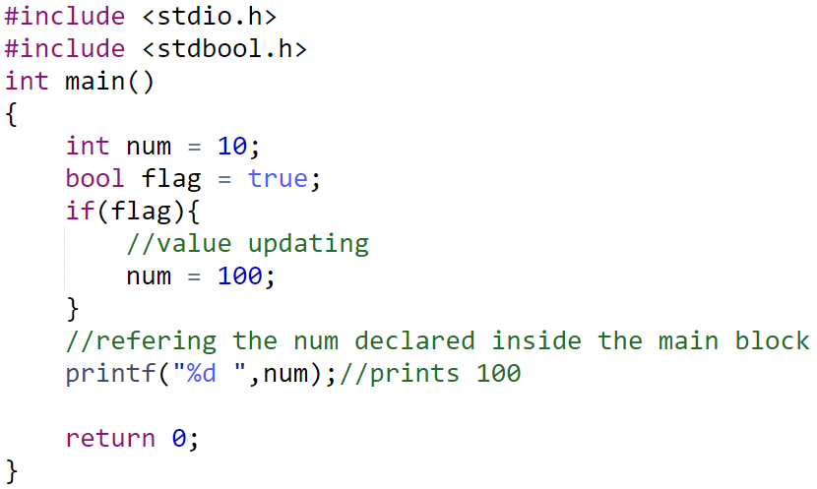
Block Scope
updating a value of a variable from inner block

Slide 11
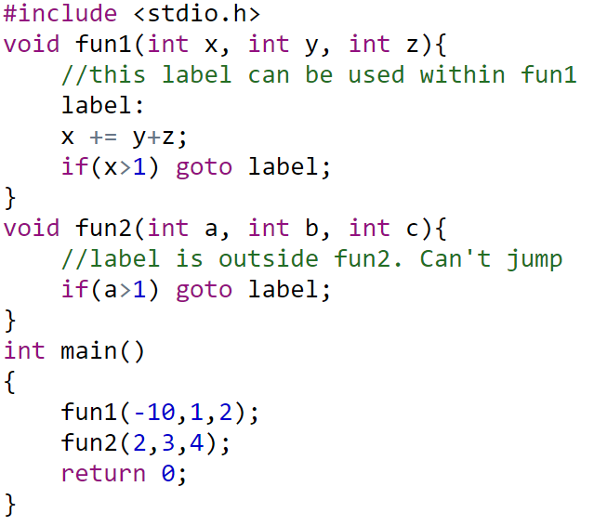
Function Scope
Only statement labels have function scope. An identifier with function scope is unique throughout the function in which it is declared.
Labeled statements are used as targets for goto statements and are implicitly declared by their syntax, which is the label followed by a colon ( :) and a statement.

Slide 12
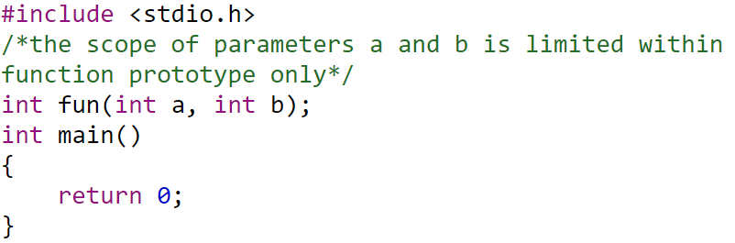
Function Prototype Scope
An identifier that appears within a function prototype’s list of parameter declarations has function prototype scope. The scope of such an identifier begins at the identifier’s declaration and terminates at the end of the function prototype declaration list.
In this example, the identifiers (a, b) have scope beginning at their declarations and ending at the closing parenthesis. In effect, these identifiers are merely placeholders for the actual parameter names to be used after the function is defined.

Slide 13
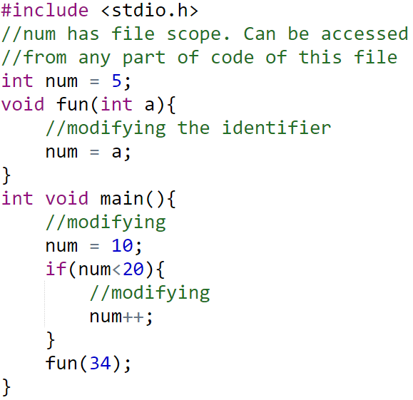
File Scope
An identifier whose declaration is located outside any block or function parameter list has file scope. An identifier with file scope is visible from the declaration of the identifier to the end of the compilation unit, unless hidden by an inner block declaration. In the following example, the identifier num has file scope:

Slide 14
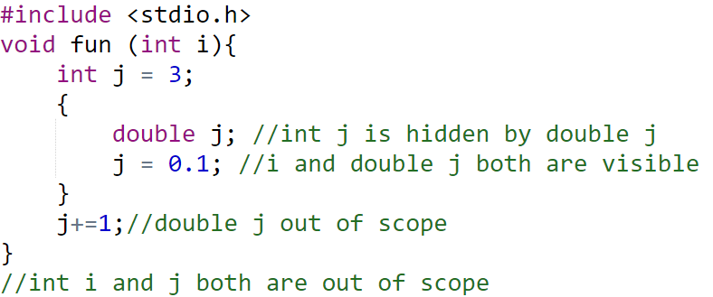
Visibility of an Identifier
The visibility of an identifier is a region of the program source code from which an identifier’s associated object can be legally accessed.
Scope and visibility usually coincide, though there are circumstances under which an object becomes temporarily hidden by the appearance of a duplicate identifier: the object still exists but the original identifier cannot be used to access it until the scope of the duplicate identifier ends.
Technically, visibility cannot exceed a scope, but a scope can exceed visibility.

Slide 15
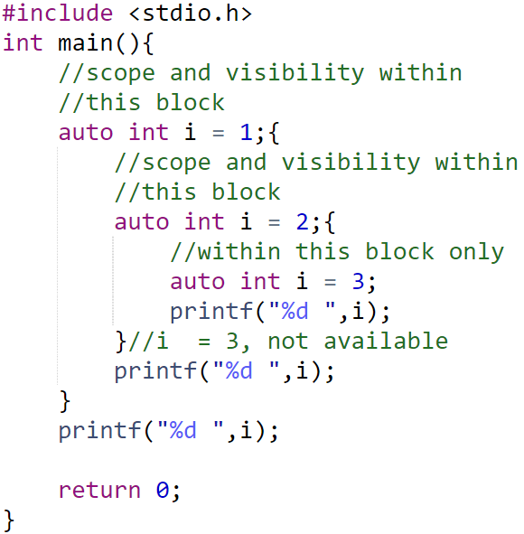
Automatic Storage Class (auto)
A variable defined within a function or block with auto specifier belongs to automatic storage class. All variables defined within a function or block by default belong to automatic storage class if no storage class is mentioned. Variables having automatic storage class are local to the block which they are defined in, and get destroyed on exit from the block.

Slide 16
Register Storage Class
The register specifier declares a variable of register storage class.
Variables belonging to register storage class are local to the block which they are defined in, and get destroyed on exit from the block.
A register declaration is equivalent to an auto declaration, but hints that the declared variable will be accessed frequently; therefore they are placed in CPU registers, not in memory.
However, if a variable is declared register, the unary & (address of) operator may not be applied to it, explicitly or implicitly.
Register variables are also given no initial value by the compiler.

Slide 17
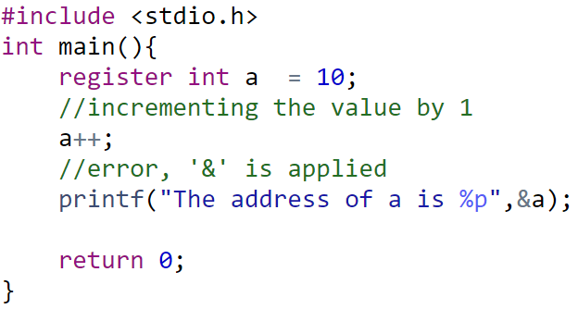
Register Storage Class

Slide 18
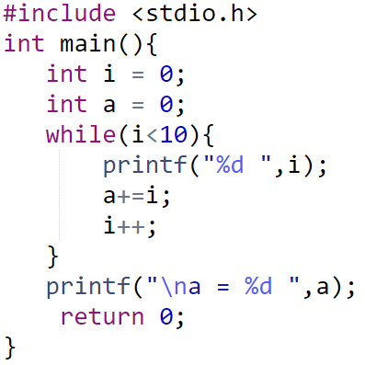
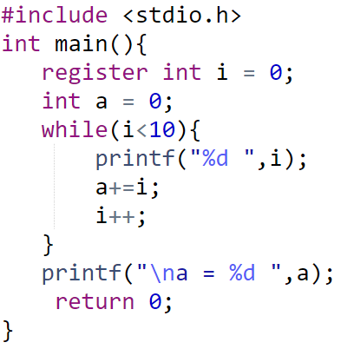
Why prefer register over auto?
Check in this program how many times ‘i’ and ‘a’ is accessed.?
The location of ‘i’ is accessed very frequently by CPU in above marked source lines. So placing such identifier in CPU register can reduce time for execution.

Slide 19
Static storage class
The static specifier gives the declared variable static storage class.
Static variables can be used within function or file.
Unlike global variables, static variables are not visible outside their function or file, but they maintain their values between calls.

Slide 20
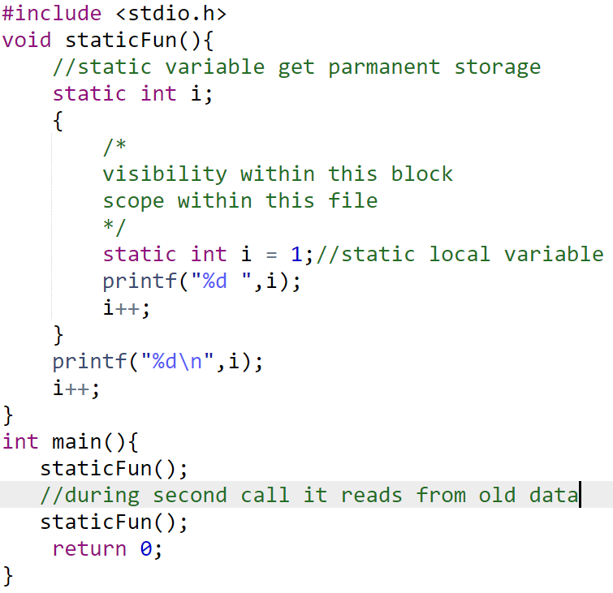
Static storage class as local

Slide 21
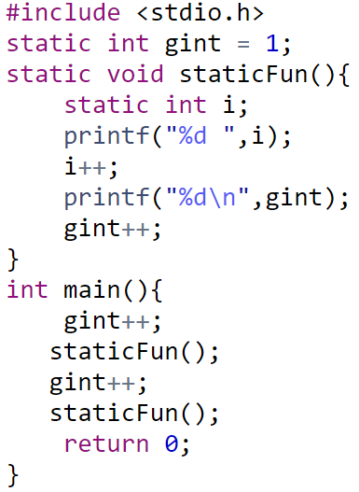
Static storage class as global
When static specifier is applied to a global variable or a function then compiler makes that variable or function known only to the file in which it is defined. A static global variable has internal linkage that means even though the variable is global; routines in other files have no knowledge of it and cannot access and alter its contents directly.

Slide 22
extern storage class
The extern specifier gives the declared variable external storage class. The principal use of extern is to specify that a variable is declared with external linkage elsewhere in the program.
To understand why this is important, it is necessary to understand the difference between a declaration and a definition.
A declaration declares the name and type of a variable or function. A definition causes storage to be allocated for the variable or the body of the function to be defined.
When extern specifier is used with a variable declaration then no storage is allocated to that variable and it is assumed that the variable has already been defined elsewhere in the program.
When extern specifier is used with a variable declaration then no storage is allocated to that variable and it is assumed that the variable has already been defined elsewhere in the program.

Slide 23
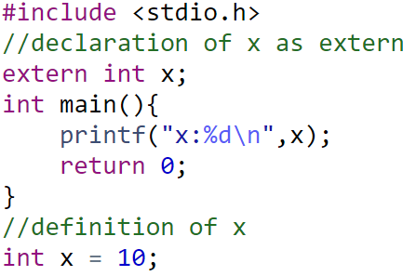
extern storage class
When we use extern specifier the variable cannot be initialized because with extern specifier variable is declared, not defined.
if you change the statement extern int x; to extern int x = 50; you will again get an error ”Redefinition of ’x’” because with extern specifier the variable cannot be initialized, if it is defined elsewhere. If not then extern declaration becomes a definition.
Note that extern can also be applied to a function declaration, but doing so is redundant because all function declarations are implicitly extern.

Slide 24
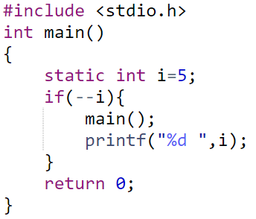
Find the Output
4 3 2 1
1 2 3 4
0 0 0 0
Compiler Error

Slide 25
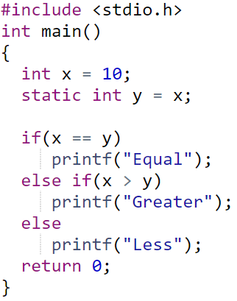
Find the Output
Compiler Error
Equal
Greater
Less

Slide 26
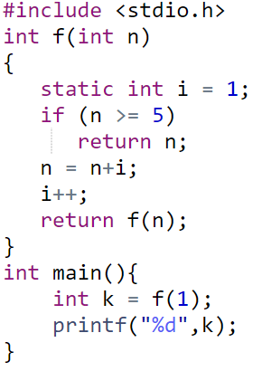
Find the Value of k
5
6
7
8

Slide 27
Thank You

